Slide 1
Presentation on
ChatBot In Python using NLTK
Presented By:
Ms Sayali Bharat Maskar Roll No:348
Ms Nikita Santosh Kale Roll No:335
Ms Ujjwala Parmeshwar sable Roll No:364
Ms Asmita Pramod Kore Roll No:343
Guided By:
Prof S.S. Nimbalkar
Department Of Computer
Engineering

Slide 2
Introduction
What is ChatBot?
A ChatBot is a computer software able to interact with humans using a natural language
Our boat will ne used for small talk,as to answer some bot related questions

Slide 3
Use of NLTK in chatBot
This chatBot has ability to parse a document of textual information and answer the queries of user.The chatBot uses the natural langauges processing toolkit(NLTK) to process the textual information

Slide 4
How does a chatBot works?
ChatBot are nothing but the software applications that have an application layer,the database,and APIS.To simplify the working of chatBot,we can say it works on pattern matching to classify text and produce a suitable response for the questins /queries addressesd by the user.The chatBot responds to the user as per the program that has been fed in it.ChatBots are of different types,depending on how they are used here in our mini project we created rule based chatBot

Slide 5
Rule based chatBot:
This is the basic chatBot made,the user interacts with this kind of bot by using predefined options.To get answers from these bots,users need to click on certain options,These kinds of bots collect the users request ,analyze it ,and then offer results in the form of buttons.These bots are commonly used to replace frequently asked questions when it comes to comes to complex queries; they aren’t the always best solution

Slide 6
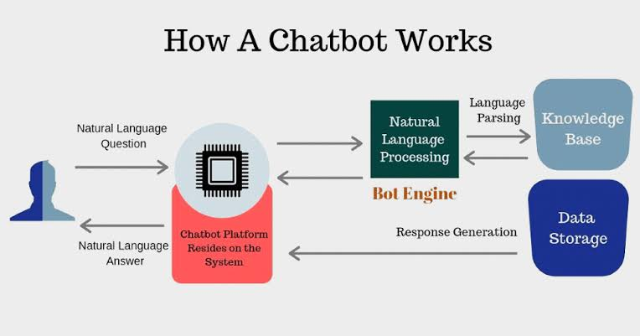

Slide 7
Future works
More efficient chatbot
Language Independent chatbot

Slide 8
Conclusion
Building a chatBot with NLTK was not only simple ,but also ,the results were accurate. With Artificial Intelligence and machine learning ,in advancement ,everything and anything is possible to achieve whether it is creating bots with conversational skills like humans or be it anything else.

Slide 9
THANK
YOU

